Slide 1
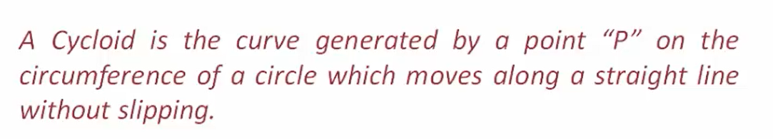
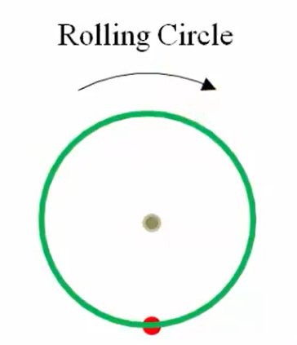

Cycloid
C
$$πD$$
P

Slide 2

Steps to construct cycloid:
1.Draw a rolling circle with specified diameter/radius and plot point C as a center point and P as a base base point.
2. From a point P draw a straight line which is equal to circumference of a rolling circle ($∏D)$
3. Draw horizontal line from point C which is parallel to the straight line passing through point P
6
B
7
5
4. Divide the circle into equal number of parts
And assign numbers as shown in fig.
8
4
4. Divide straight line passing through point P and C into equal number of parts And assign numbers as shown in fig.
C
C1
C2
C3
C4
C5
C6
C7
C8
C9
C10
C11
C12
9
3
10
2
5. Draw horizontal lines from each point of circle.
11
1
P
6. Take C1 as a center and radius of a rolling circle mark the arc point on a line which is passing through point 1
7. Take C2 as a center and radius of a rolling circle mark the arc point on a line which is passing through point 2
8. Repeat above steps i.e. step 6 and 7 for all points (upto C12)
9. Joint all points and draw cycloid.

Slide 3
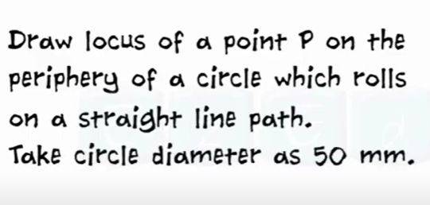
Problem 1 :

Slide 4
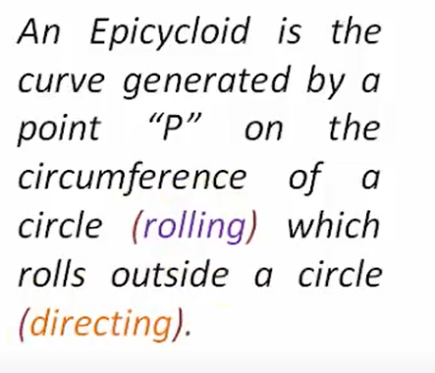
Epicycloid
C
Rolling circle
P
Ꝋ
O
Directrix circle
Ꝋ = radius of rolling circle ( r ) / radius of directrix circle ( R )

Slide 5
Steps to construct epicycloid:
1. specify a point O and draw one horizontal line
6
5
4
C3
C4
2. Calculate angle by using following formula
Ꝋ = ( r / R ) X 360
C2
C5
7
C6
C
C1
3
C7
3. From Point O mark the calculated angle and draw line.
8
2
C8
4. Draw directrix circle with specified radius and O as a center point. also plot point P
9
1
C9
5. Mark radius distance of rolling circle from point P
10
P
11
C10
6. Draw rolling circle with specified radius and C as a center point.
C11
7. Draw an arc from point C with O as a center.
Ꝋ
8. Divide rolling circle and an arc which is passing through point C into equal number of parts and assign numbers.
O
9. Draw an arc from each point of rolling circle.
10. C1 as a center and radius equal to rolling circle and mark the point on arc passing through point 1
11. C2 as a center and radius equal to rolling circle and mark the point on arc passing through point 2
12. Repeat above steps i.e. step 6 and 7 for all points (upto C12)
13. Joint all points and draw cycloid.

Slide 6
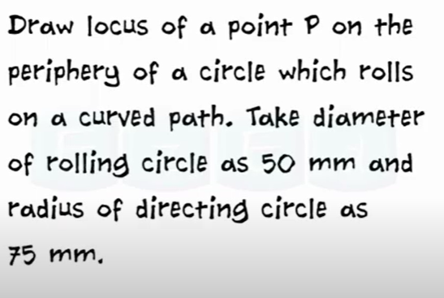
Problem 1 :

